Slide 1

GULP
FICTION
Character
Notebook
‘An Inspector Calls’
By
J.B Priestley
Watch the GULP FICTION explanation videos for each quote. Then, as you watch, pause and take notes in this pack.
gulpfiction.co.uk

Slide 2
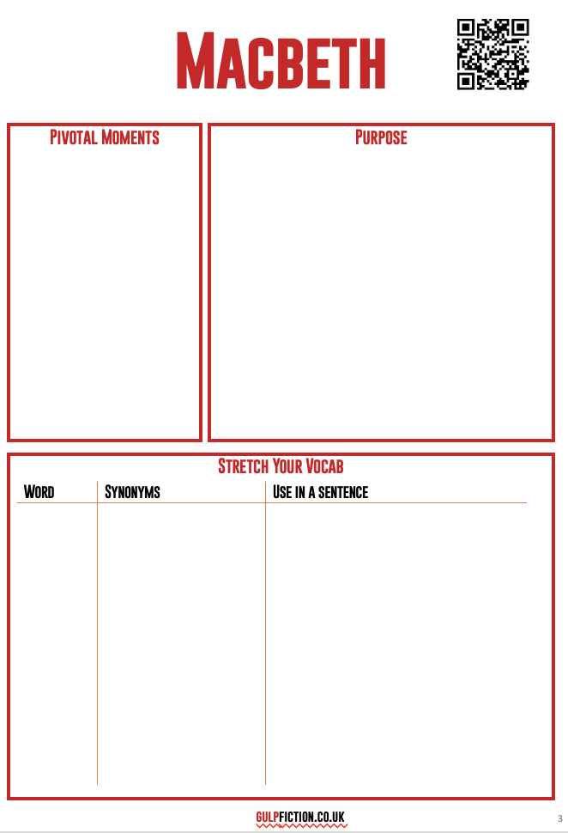
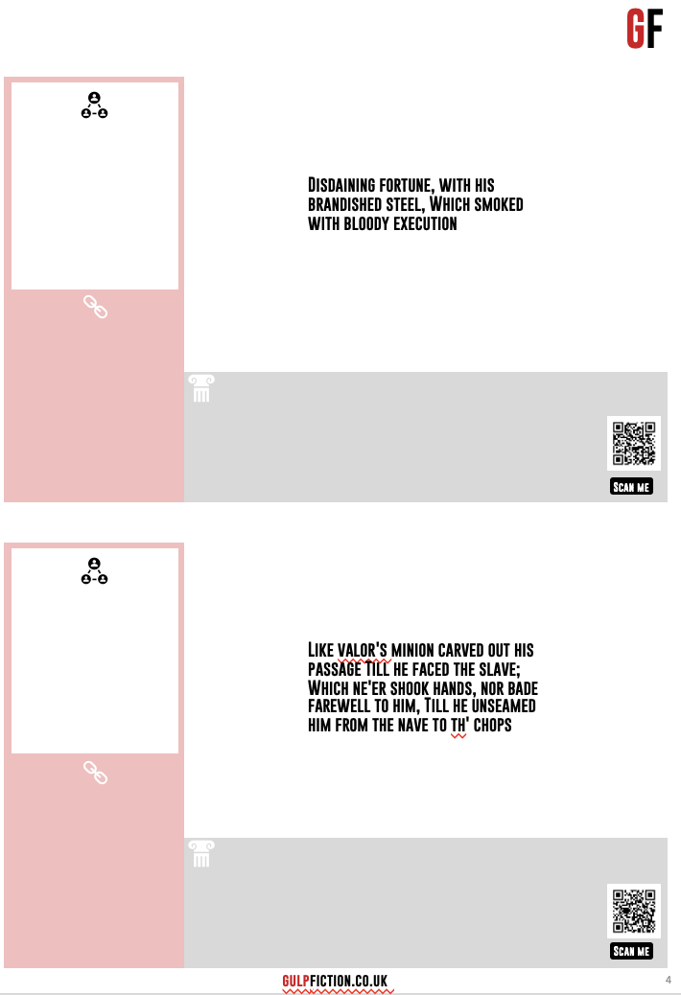
How to use the notebook
Scan the QR to find more information on pivotal moments, the character’s purpose and stretch vocabulary
Use Google to look up any familiar words and put them in a sentence about the character
A summary of the quote. Who says it and what’s going on
Other quotes that link to the one you are analysing
Any historical context that might be useful
Language analysis goes around the quote
Scan the QR to go to the analysis
Remember to have a go at getting all your ideas and knowledge down before you go to the website or videos!

Slide 3
Mr Birling
Pivotal Moments
Purpose
Stretch Your Vocab
Word
Synonyms
Use in a sentence
gulpfiction.co.uk/birling

Slide 4



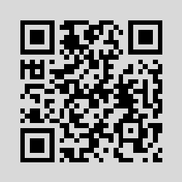
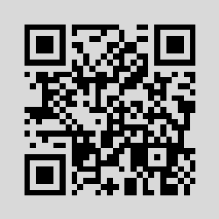
GF
“We may look forward to the time when Crofts and Birlings are no longer competing but are working together – for lower costs and higher prices.”
Scan me
“You’ll hear some people say that war is inevitable. And to that I say – fiddlesticks!”
Scan me
gulpfiction.co.uk

Slide 5
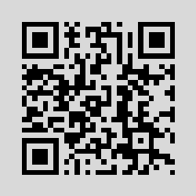
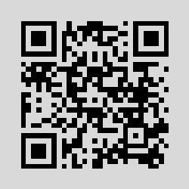
GF
“By the way some of these cranks talk and write now, you’d think everybody has to look after everybody else, as if we were all mixed up together like bees in a hive – community and all that nonsense.”
Scan me
“If you don’t come down sharply on some of these people, they’d soon be asking for the earth.”
Scan me
gulpfiction.co.uk

Slide 6
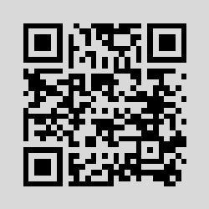
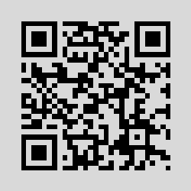
GF
“A man has to mind his own business and look after himself and his own – and – We hear the sharp ring of a front doorbell.
Scan me
‘It’s my duty to keep labour costs down.’
Scan me
gulpfiction.co.uk

Slide 7
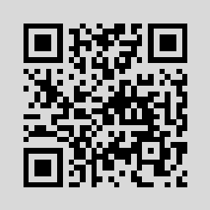
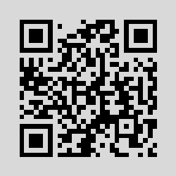
GF
‘I can’t accept any responsibility … If We Were All Responsible for Everything That Happened to Everybody We’d Had Anything to Do with, It Would Be Very Awkward Wouldn’t It?”
Scan me
“The famous younger generation who know it all. And they can’t even take a joke!”
Scan me
gulpfiction.co.uk

Slide 8
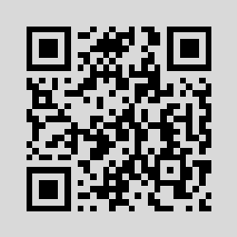
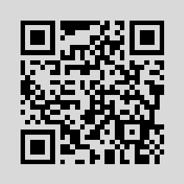
GF
“Perhaps I ought to warn you that the Chief Constable is and old friend of mine. We play golf together.”
Scan me
“There’ll be a public scandal… and who here will suffer for that more than I will?”
Scan me
gulpfiction.co.uk

Slide 9
Mrs Birling
Pivotal Moments
Purpose
Stretch Your Vocab
Word
Synonyms
Use in a sentence
gulpfiction.co.uk/mrsbirling

Slide 10
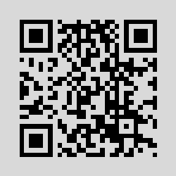
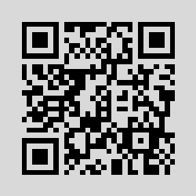
GF
'Now Sheila don’t tease him. When you're married you'll realise that men with important work to do sometimes have to spend nearly all their time and energy on their business.'
Scan me
“That - I consider - is a trifle impertinent Inspector.”
Scan me
gulpfiction.co.uk

Slide 11
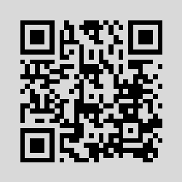
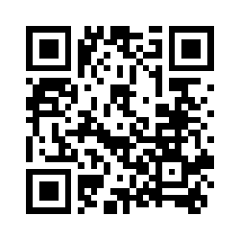
GF
“Girls of that class-”
Scan me
‘You know of course that my husband was lord Mayor only two years ago and that he’s still a magistrate.’
Scan me
gulpfiction.co.uk

Slide 12
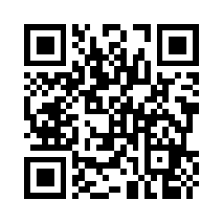
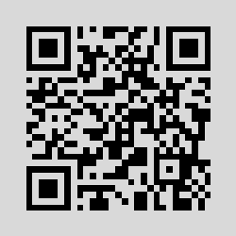
GF
(staggered) Well, really! Alderman Meggarty! I must say, we are learning something tonight'
Scan me
‘Gerald you’ve argued this very cleverly and I’m most grateful’
Scan me
gulpfiction.co.uk

Slide 13
Sheila
Pivotal Moments
Purpose
Stretch Your Vocab
Word
Synonyms
Use in a sentence
gulpfiction.co.uk/sheila

Slide 14
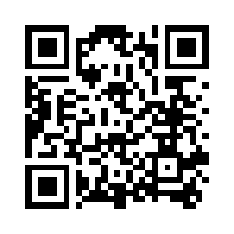
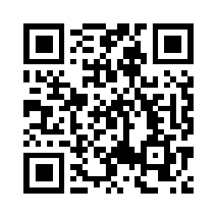
GF
'(Excited) Oh – Gerald – you’ve got it – is it the one [ring] you wanted me to have?'
Scan me
'But these girls aren’t cheap labour – they’re people.'
Scan me
gulpfiction.co.uk

Slide 15
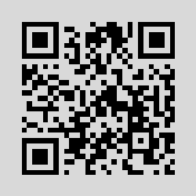

GF
'I told him that if they didn’t get rid of that girl, I’d never go near the place again and I’d persuade mother to close our account with them’
Scan me
'(laughs rather hysterically) Why – you fool – he knows. Of course he knows. And I hate to think how much he knows that we don’t know yet. You’ll see. You’ll see.'
Scan me
gulpfiction.co.uk

Slide 16
Eric
Pivotal Moments
Purpose
Stretch Your Vocab
Word
Synonyms
Use in a sentence
gulpfiction.co.uk/eric

Slide 17
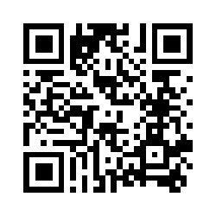
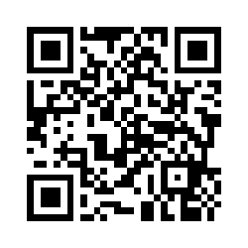
GF
‘not quite at ease, half shy, half assertive’
Scan me
“I was in that state when a chap easily turns nasty.”
Scan me
gulpfiction.co.uk

Slide 18
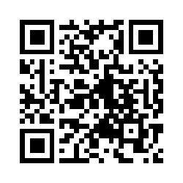
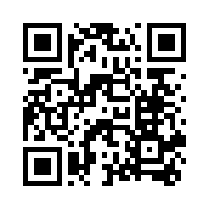
GF
“She was pretty and a good sport”
Scan me
Then – you killed her. She came to you to protect me – and you turned her away – yes, and you killed her – and the child she'd have had too – my child – your own grandchild – you killed them both – damn you, damn you
Scan me
gulpfiction.co.uk

Slide 19
Gerald
Pivotal Moments
Purpose
Stretch Your Vocab
Word
Synonyms
Use in a sentence
gulpfiction.co.uk/gerald

Slide 20
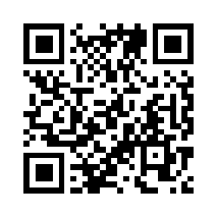
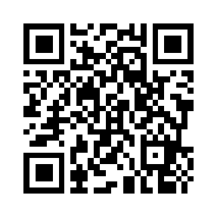
GF
After all, y'know, we're respectable citizens and not criminals
Scan me
“she was pretty - soft brown hair and big dark eyes - [breaks off] My God!”
Scan me
gulpfiction.co.uk

Slide 21
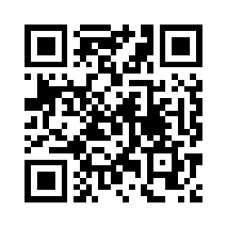
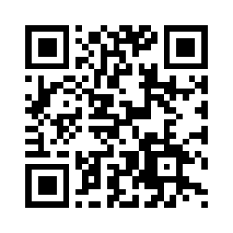
GF
sorry – I – well, I've suddenly realized – taken it in properly – that's she's dead--
Scan me
'Everything's all right now Sheila. (Holds up the ring.) What about this ring? '
Scan me
gulpfiction.co.uk

Slide 22
Inspector Goole
Pivotal Moments
Purpose
Stretch Your Vocab
Word
Synonyms
Use in a sentence
gulpfiction.co.uk/goole

Slide 23
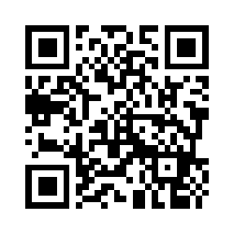
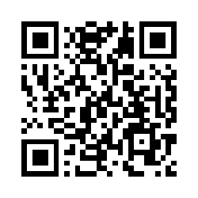
GF
“He creates at once an impression of massiveness, solidity and purposefulness”
Scan me
“It would do us all a bit of good if sometimes we tried to put ourselves in the place of these young women counting their pennies in their dingy little back bedrooms.”
Scan me
gulpfiction.co.uk

Slide 24
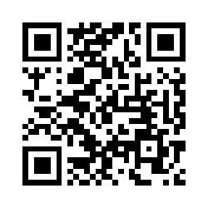
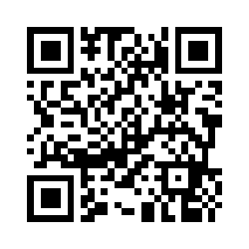
GF
“Public men, Mr Birling, have responsibilities as well as privileges.”
Scan me
“But remember this. One Eva Smith has gone- but there are millions and millions and millions of Eva Smiths and John Smiths still left with us, with their lives, their hopes and fears, their suffering and chance of happiness, all intertwined with our lives”
Scan me
gulpfiction.co.uk

Slide 25
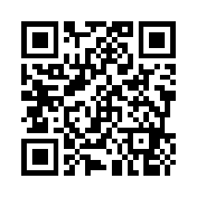
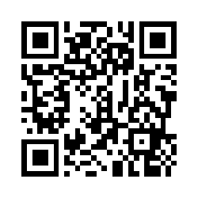
GF
“We have to share something. If there’s nothing else, we must have to share our guilt”
Scan me
“They will be taught it in fire and blood and anguish”
Scan me
gulpfiction.co.uk

